Slide 1
Equity & Family Engagement Early Learning Hubs
Technical assistance webinar
2014
PRESENTED BY
Brett Walker
Early Learning Division

Slide 2
Agenda
Hub overview
Presentation
Questions & Answers
Upcoming events
Contact information
Heidi McGowan
Webinar Facilitator

Slide 3
Early Learning Council Goals
The goals
Children ready for success in kindergarten when they arrive.
Children raised in stable and attached families.
Services that are integrated and aligned into one early learning system focused on results.

Slide 4
Early Learning Hubs
What is an Early learning hub?
A self-organized community-based coordinating body created to provide a “system approach” to early childhood education that works to improve efficiency and outcomes for our youngest children.

Slide 5
Early Learning Hubs
Early learning hub Will
Build on existing community resources and assets.
Ask tough questions about what could be done differently to get better results, especially for children at risk.
Communities have the option to define their own strategies and service areas to achieve the outcomes.
Under the community based leadership of Early Learning Hubs bring public schools, early learning providers, health care, social services and the private sector together around shared outcomes, for the first time in Oregon’s history.

Slide 6
Presentation
Equity & Family Engagement
Notes:
This Early Learning Hub model will build on existing community resources and assets, while also asking tough questions about what could be done differently to get better results, especially for at risk children.
Communities have the option to define their own strategies and service areas via their Early Learning Hubs, with a focus on:
Working across traditional program and sector silos for collective community accountability for readiness.
Finding the children in each community that need help the most.
Working with families to identify their unique and specific needs.
Linking families with services and providers who can best address their needs.
Accounting for outcomes collectively and cost effectively.
Under the community based leadership of Early Learning Hubs, Oregon will bring public schools, early learning providers, health care, social services and the private sector together locally, around shared outcomes, for the first time in Oregon’s history.
It’s an exciting time for early childhood education in Oregon and we want you to be part of it.
Want to know more? Check out these resources:
2013 Early Learning Council legislative report .
Early Learning Hub Timeline.
Early Learning Hub Frequently Asked Questions
Tell us your story and share your thoughts .
Link to: http://www.ssireview.org/articles/entry/collective_impact
Link to a PDF of the report
Link to a PDF of the timeline
Link to the FAQ page
Link to community feedback page.

Slide 7
Defining Equity
How do you define equity?
We are not looking for a ‘correct’ answer or a dictionary definition....what does equity mean to you?
Use the chat box to share your thoughts and ideas.

Slide 8
The Equity Lens
Provides a set of shared beliefs, vocabulary, and vehicle for identifying and addressing disparities.
Focused on closing opportunity gaps between:
Children of color and/or children in poverty and more affluent and/or white peers
Oregon and the rest of the country.
http://education.oregon.gov/Documents/Final%20Equity%20Lens%20Adopted.pdf

Slide 9
The Equity Lens: Core Beliefs
Everyone has the ability to learn.
Speaking a language other than English is an asset.
Children who receive special education services are an integral part of our educational system, and we must welcome the opportunity to be inclusive.
Children who have been described as “at risk” represent our best opportunity to improve outcomes.
Communities have unique and important solutions for improving outcomes for all children.
Resource allocation demonstrates priorities.
Ending disparities and gaps in achievement begins with parent engagement and support, and the delivery of high quality early learning services.

Slide 10
The Equity Lens: Key Questions to Guide Decision-Making
Who are the racial/ethnic and underserved groups affected?
Does the decision being made ignore or worsen existing disparities?
How does the investment or resource allocation advance the 40/40/20 goal?
What are the barriers to more equitable outcomes?
What is the impact on eliminating opportunity gaps?
How are you collecting data on race, ethnicity and native language?
How will you modify or enhance your strategies to ensure each child and communities’ individual and cultural needs are met?
What is your commitment to professional learning for equity?

Slide 11
Using a Continuous Improvement Model to Operationalize the Equity Lens
Convene
Assess
Design
Execute
Evaluate
Notes:
When talking about “convene”, make sure to address issue of having cross sector group at the table, including
Assess: What do the data tell you? Do root cause analysis, and take a critical look at practices and policies at the local level that may be contributing to disparities. Use AHR Equity Assessment as example of “Assess”. Make sure to note that while this specific tool is focused specifically on racial equity, we know that we’re not just talking about race and that poverty may be a more important factor in many communities.
Design/Execute = strategic planning process and implementation
Use KA Data as example of “Evaluate”

Slide 12
Defining Family Engagement
How do you define family engagement?
We are not looking for a ‘correct’ answer or a dictionary definition....what does equity mean to you?
Use the chat box to share your thoughts and ideas.
Notes:
Key words: process, relationship, learning and development
Be sure to note that family engagement is not an end unto itself, but is in fact a strategy for improving child outcomes

Slide 13
Taking Engagement from ‘Program to Practice’
Family engagement…
Is a shared responsibility
Is continuous across a child’s life
Occurs in multiple settings where children learn
Source: http://www.hfrp.org/publications-resources/browse-our-publications/family-engagement-as-a-systemic-sustained-and-integrated-strategy-to-promote-student-achievement

Slide 14
Important Types of Family Engagement
Governance and decision-making (Hub)
Two-way communication (providers)
Supporting child development and learning at home (families)
Notes:
Important considerations: How will the Hub engage the voices of the families of its target population in governance and decision-making?; What are strategies that providers can put in place to build relationships and maintain two-way communication with children’s families, and how do these align to the family partnership standards in the QRIS?; how can Hub partners work together to build parents’ capacity to support healthy child development and learning at home?; How can the equity lens be applied to all of the above?
Governance example: Ensuring that parent representatives have equal voice; translating/interpreting when necessary; meetings on ‘neutral turf’; sharing decision-making info w/ public broadly (family friendly communications)l; building parent leadership capacity.
Two-way communication example: K home visiting idea (parent-teacher home visit project out of Sacramento has been identified by USDOE as a best practice)
Supporting child development and learning at home examples: Mind in the Making parent workshop series; Strengthening early literacy through home visiting.
Be sure to share concrete strategies for each type

Slide 15
Engaging Families in Decision-Making
“If a project will affect a whole neighborhood or community, the participation of community members is key to developing strategies to address problems.…A critical part of the process of ending poverty in the US must involve greatly expanding our notion of who must be engaged." --The Declaration Initiative

Slide 16
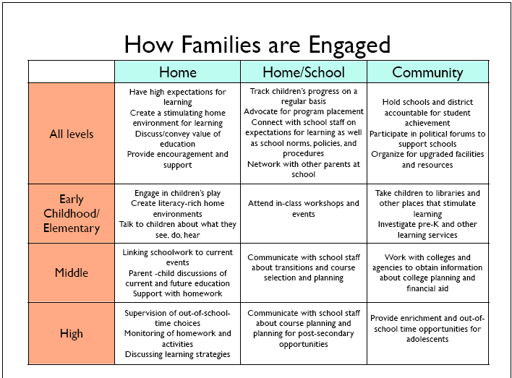

Slide 17
Components of Effective Family Engagement Strategies
Approach families from an asset perspective
Are welcoming and inclusive of all families
Meet families where they are
Require patience and persistence
Foster ongoing, two-way communication
Build families’ capacity to support children’s learning and development
Are linked to improved outcomes for children

Slide 18
Guiding Questions for Your Strategic Plan
What practices can the Hub shift to create equitable outcomes for all children and families?
Where are there persistent opportunity gaps?
Who are you having trouble reaching?
What are some strategies and practices that will help you engage the families of your target population?
What are the highest leverage family engagement opportunities?
How can you shift family engagement from ‘program to practice’ in your Hub?

Slide 19
Questions
What are your questions?

Slide 20
Webinars
March 19th Building a Strong K-3 Connection
10:00-11:00 am
March 27th Oregon’s QRIS
10:00-11:00 am
March 31st Building a Strong Health Care Connection
12:00-1:00 pm

Slide 21
Brett Walker,
Megan Irwin, Early Learning System Design Manager
megan.irwin@state.or.us
503-507-9462
www.OregonEarlyLearning.com
Contact Information

